Slide 2


Intro to Signal Processing
Rensselaer Polytechnic Institute
Notes:
Title slide:
Introduce everyone and engineering ambassadors

Slide 3
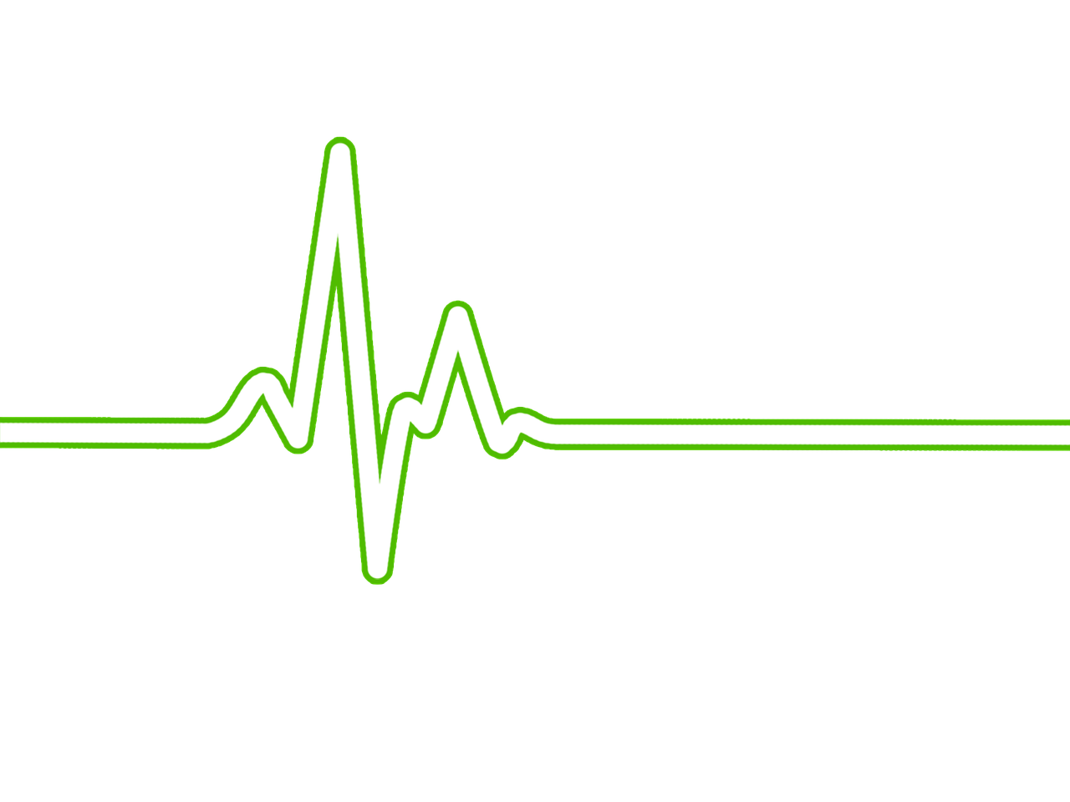
What do you remember from Week 1?
Notes:
Now that we know what an ECG is we can look at how this technology works. We will do this by amplifying a single wave from the output

Slide 4
Data science is continuously becoming more important in medical diagnostics.
1995
2013

Slide 5
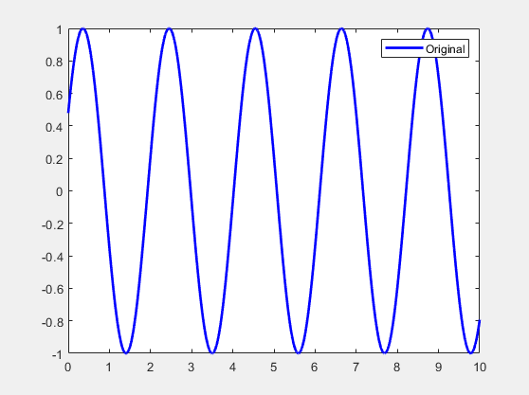
What is a signal?
Amplitude
Frequency

Slide 6
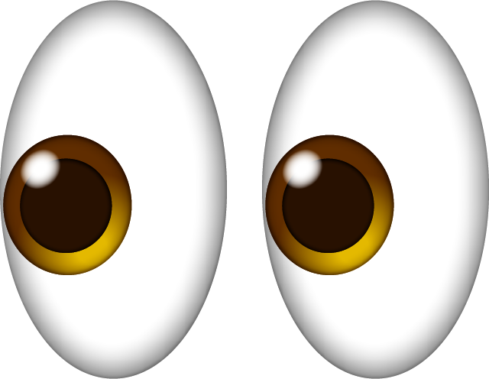
Signal Processing: Sampling Frequency
How many times you are looking at a signal

Slide 7
Signal Processing: Sampling Frequency
How many times you are looking at a signal

Slide 8
Signal Processing: Sampling Frequency
How many times you are looking at a signal
This is given in Hertz (Hz) or events per second
1 Hz
10 Hz

Slide 9
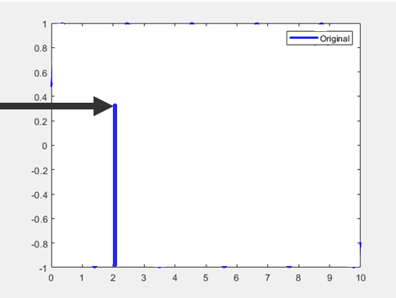
Signal Processing: Sampling Frequency
How many times you are looking at a signal

Slide 10
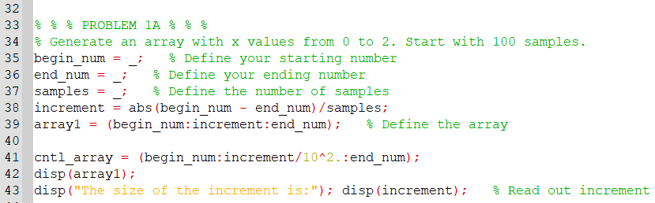
Sampling frequency in OCTAVE

Slide 11
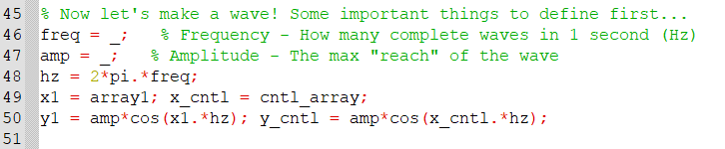
Sampling frequency in OCTAVE

Slide 12
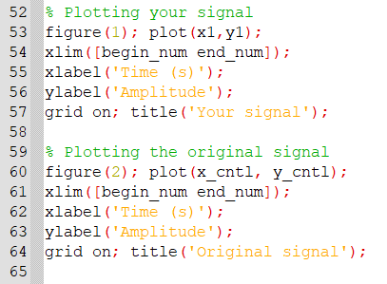
Sampling frequency in OCTAVE

Slide 13
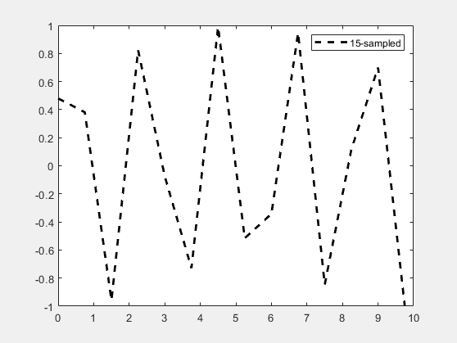
Lost data, we didn’t look enough ☹
Original Signal
15 samples
Frequency and Amplitude information lost

Slide 14

How to tell what frequencies are in a signal?

Slide 15

How to tell what frequencies are in a signal?
?
?
?
?
?
?
?
?
?
?
?
?
?
?
?
?
?
?
?
?
?
?

Slide 16

How to tell what frequencies are in a signal?
Fast Fourier Transform

Slide 17
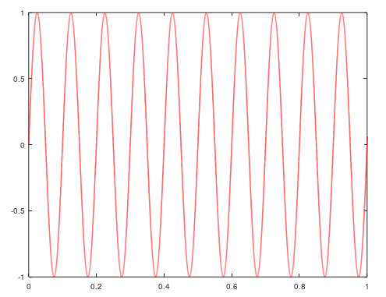

How to tell what frequencies are in a signal?
Time
FFT Algorithm

Slide 18
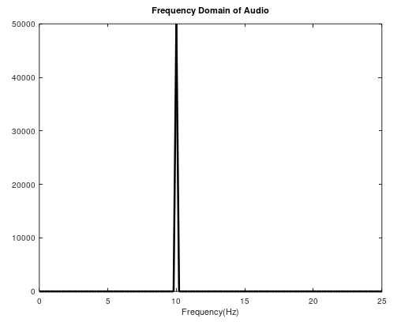
How to tell what frequencies are in a signal?
Time
Frequency
FFT

Slide 19

What if there’s more than one?

Slide 20
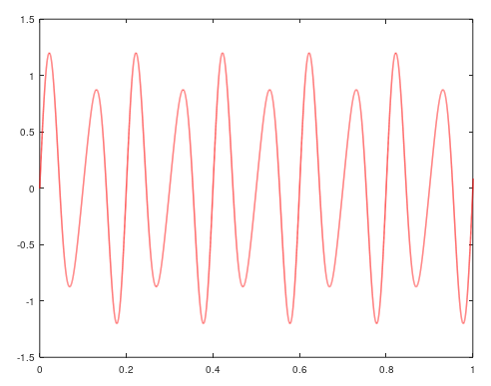
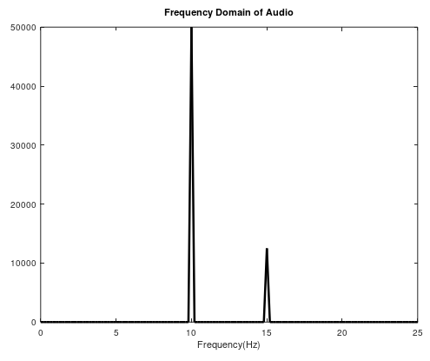
What if there’s more than one?
Time
Frequency
FFT

Slide 21

What if there’s a lot of them?

Slide 22
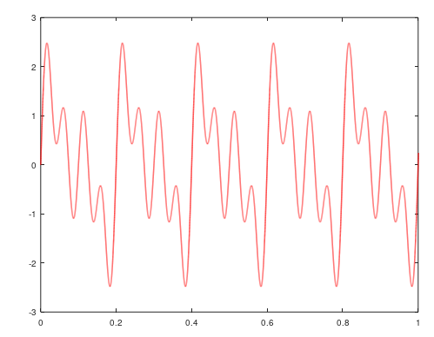
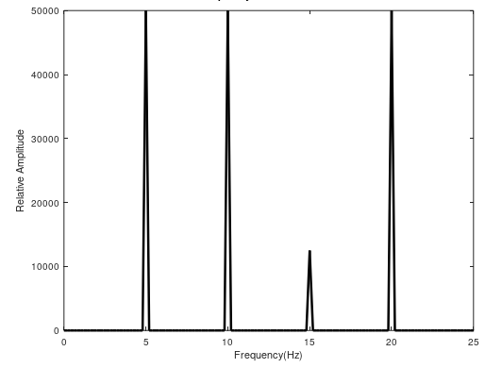
What if there’s a lot of them?
Time
Frequency
FFT

Slide 23
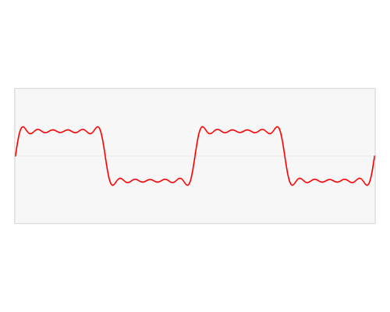

Slide 24
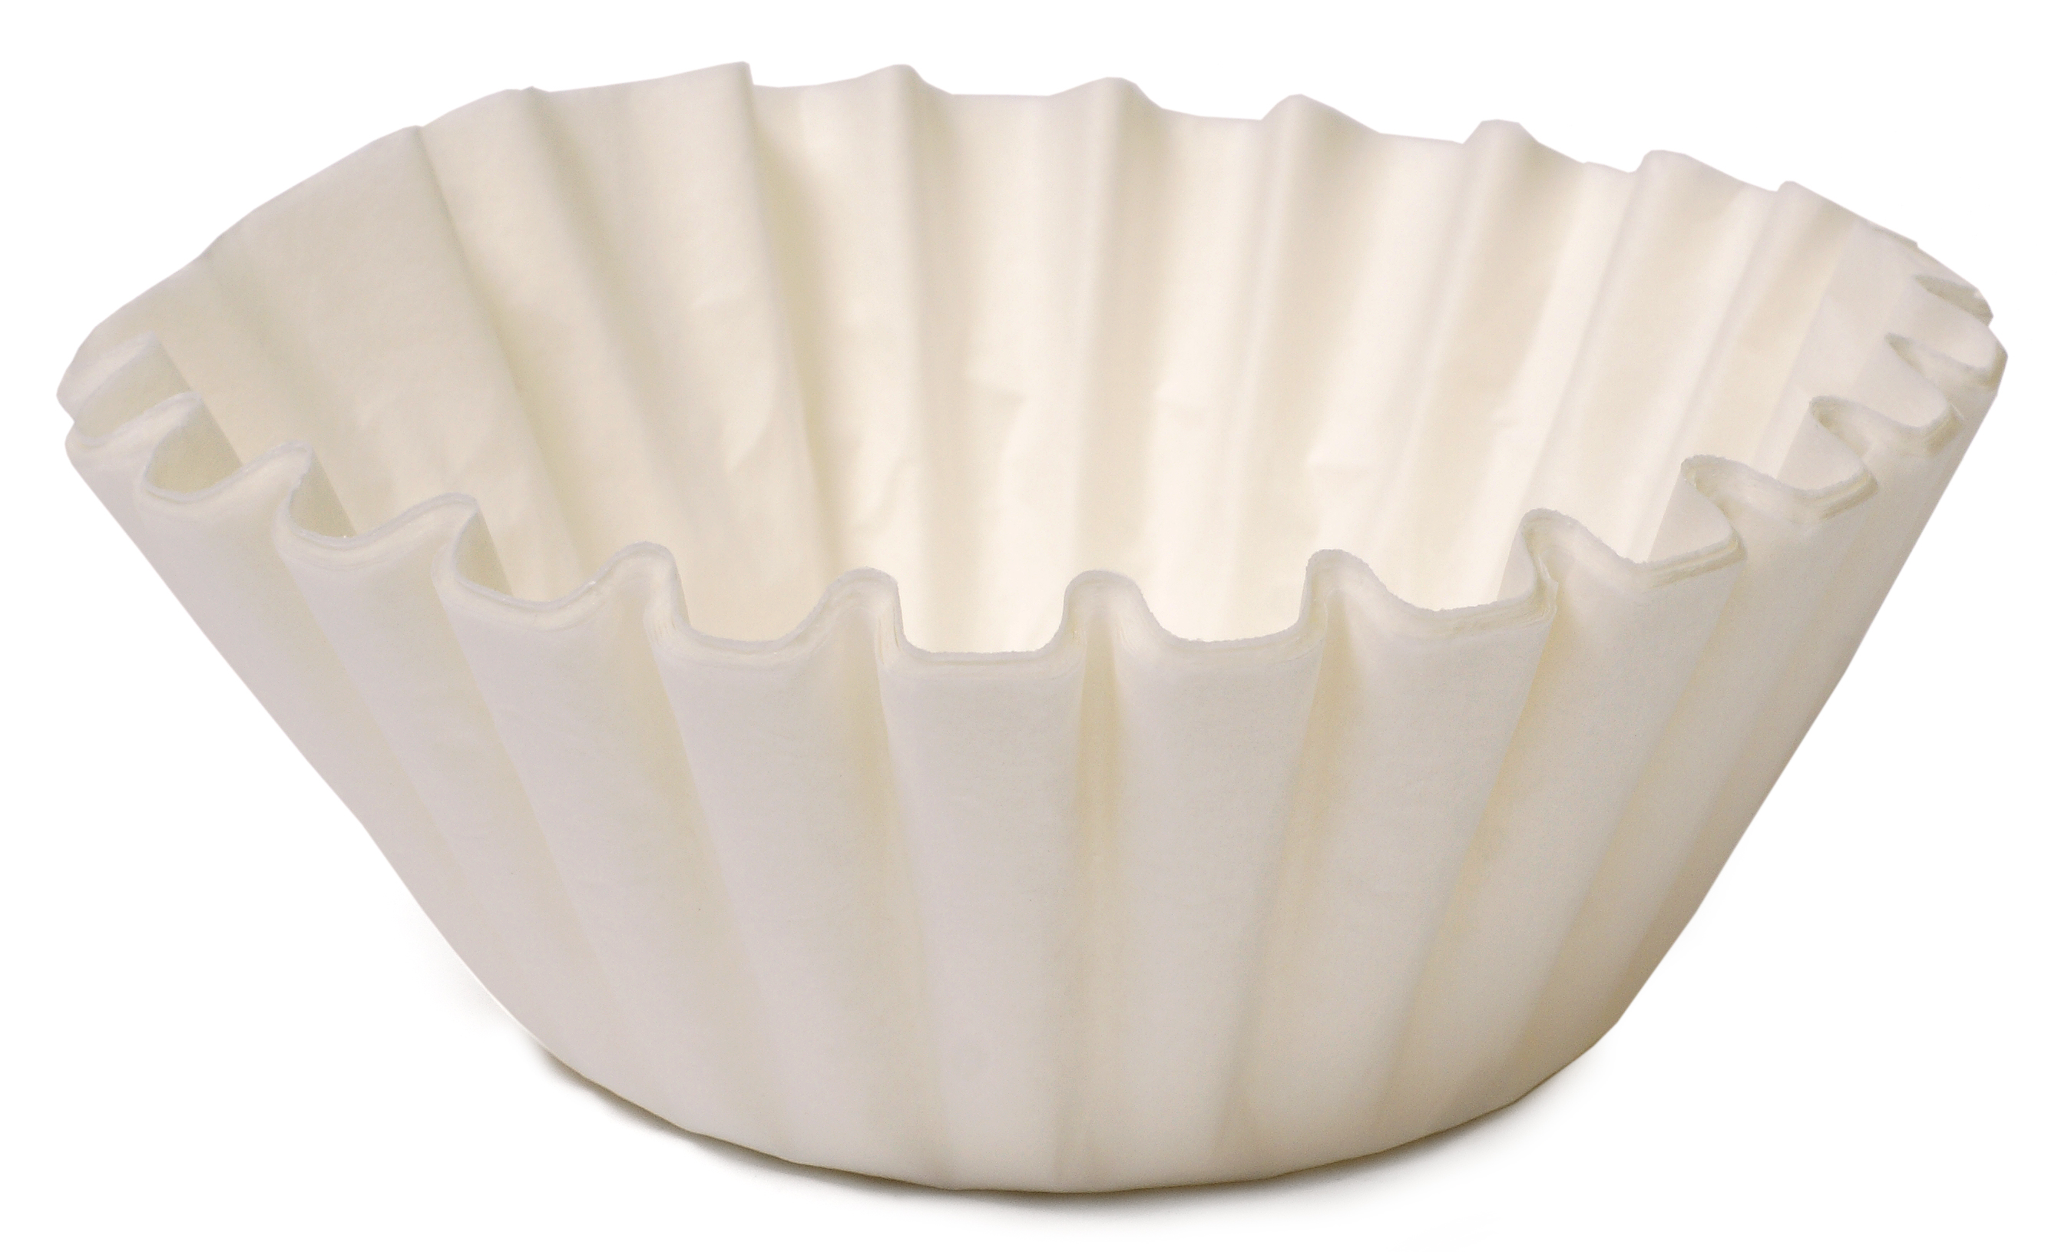
Signal Processing: Filtering

Slide 25

Signal Processing: Filtering

Slide 26
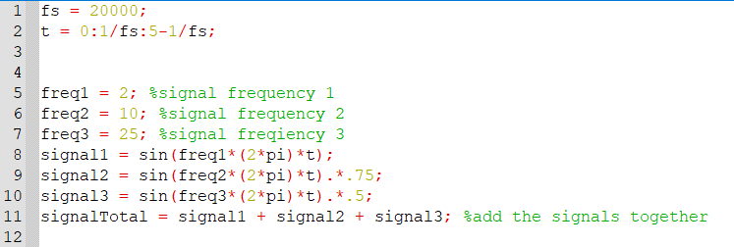
Noisy Plot

Slide 27

How to know what “size” filter we need

Slide 28
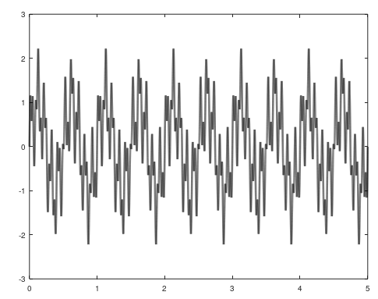
What frequencies make up this noisy plot? And how will we tell?

Slide 29
FFT!!
FFT Algorithm

Slide 30
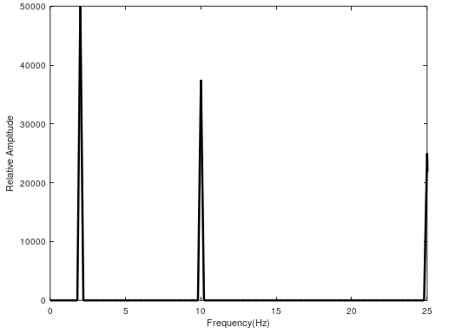
What frequencies make up this noisy plot?
FFT

Slide 31
Not one filter fits all – 3 basic filters
Lowpass

Slide 32
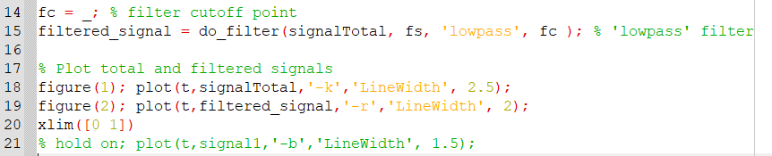
Not one filter fits all – 3 basic filters
Lowpass

Slide 33
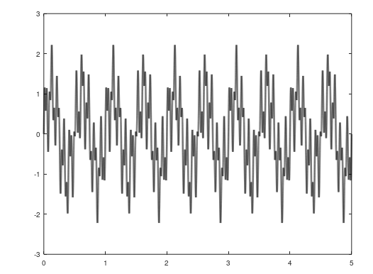
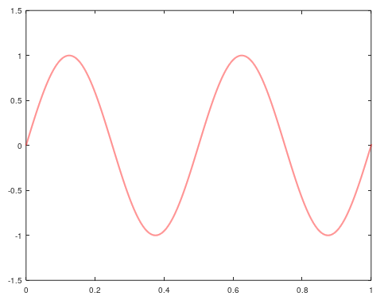
Not one filter fits all – 3 basic filters
Lowpass

Slide 34
Not one filter fits all – 3 basic filters
Highpass

Slide 35
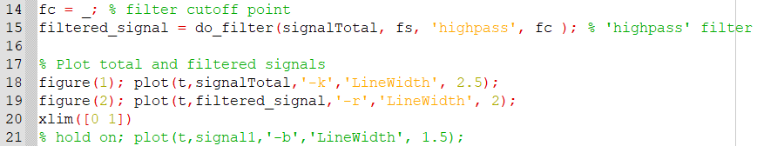
Not one filter fits all – 3 basic filters
Highpass

Slide 36
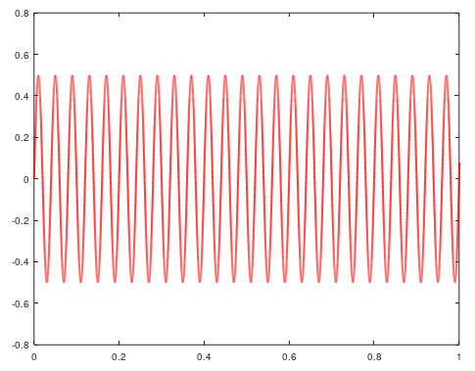
Not one filter fits all – 3 basic filters
Highpass

Slide 37
Not one filter fits all – 3 basic filters
Bandpass

Slide 38
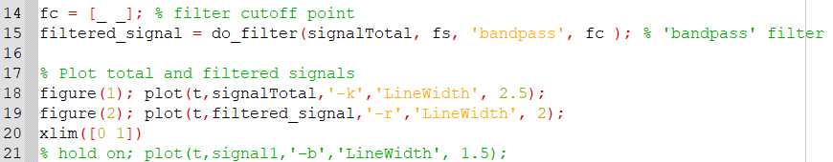
Not one filter fits all – 3 basic filters
Bandpass

Slide 39
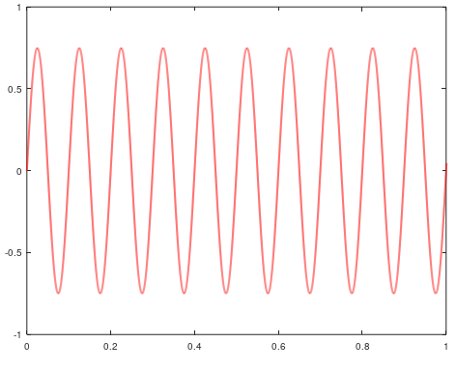
Not one filter fits all – 3 basic filters
Bandpass

Slide 40
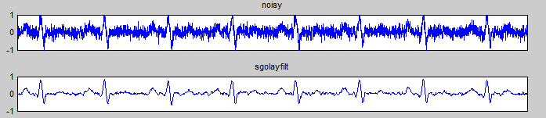
Filtering ECG data

Slide 41
ECG Filtering
Rensselaer Polytechnic Institute

Slide 42
Make sure to open ‘readECG.m’

Slide 43
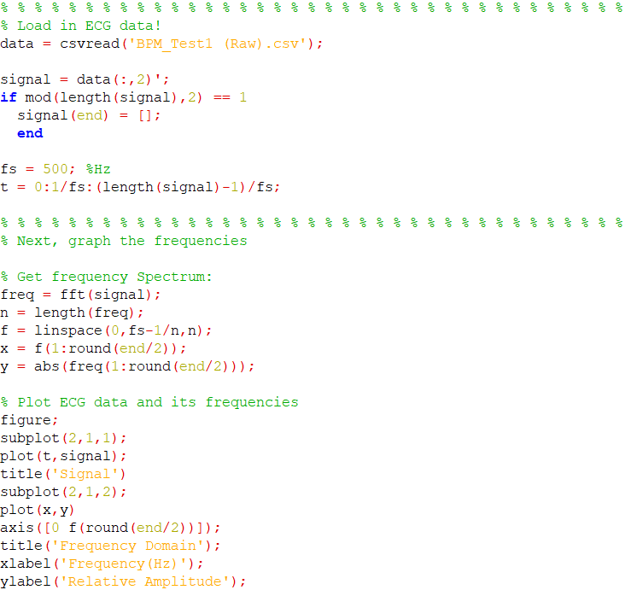

Slide 44
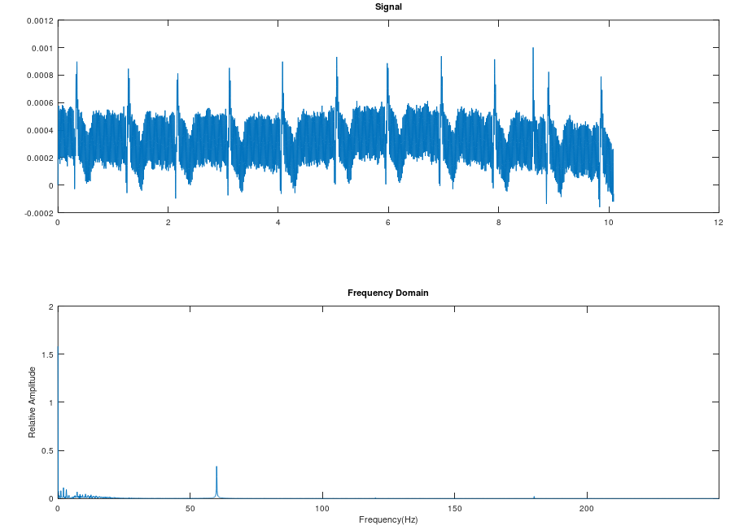

Slide 45
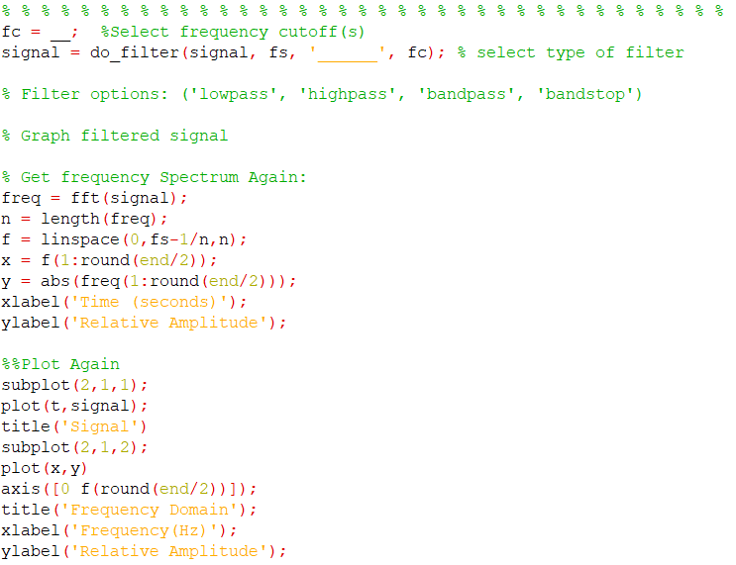

Slide 46
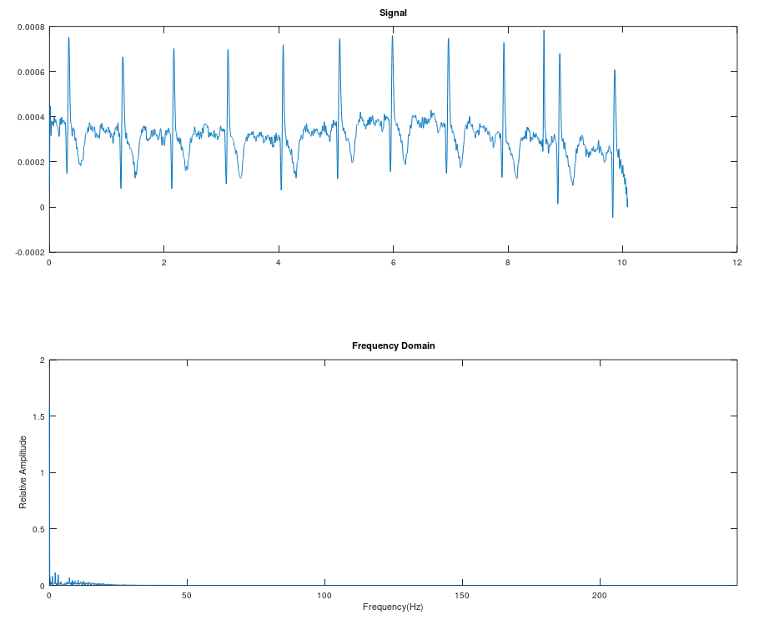
Example: Lowpass with fc = 45 Hz

Slide 47
DISCUSSION

